Slide 1
Application of Complex Functions in Mechanics
Instructor: 朱哲明 ( )
Zheming Zhu
College of Architecture and Environment, Sichuan University, China
and
Dept. of Civil Engineering, University of Toronto, Canada
Email: am.zhu@utoronto.ca; Tel:13882106617

Slide 2
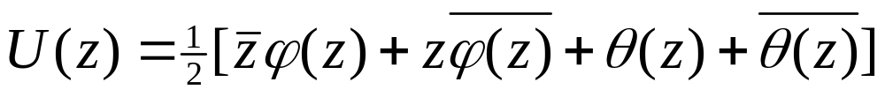
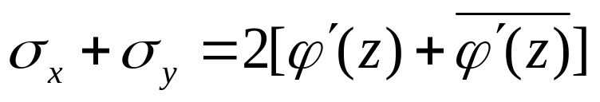
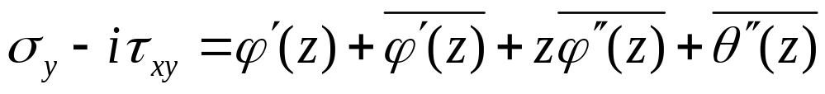
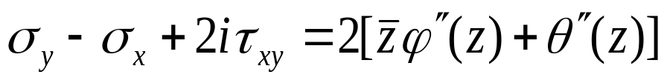
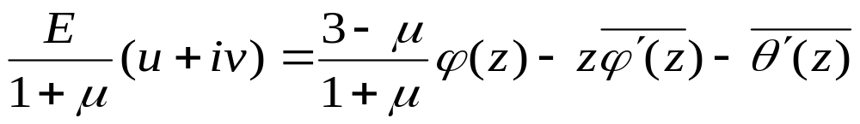
Stress function should be
Stress expressed in terms of Complex Variables
Displacement expressed in terms of Complex Variables

Slide 3

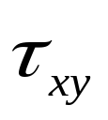
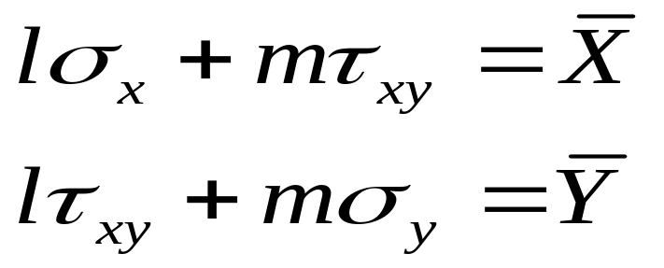
Boundary conditions
N
Suppose the length of AB is 1, then the length of AC = 1 x cosα = l ; and the length of CB = = 1 x cosβ = n
A
Y
α
β
α
σ
x
l
X
n
β
B
C
σ
y
x

Slide 4
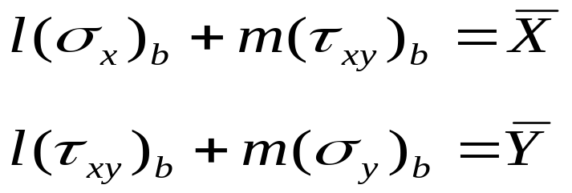
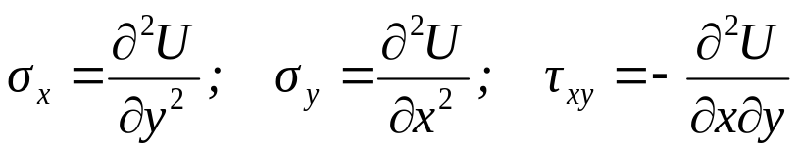
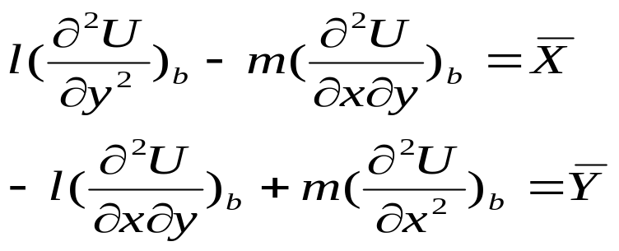






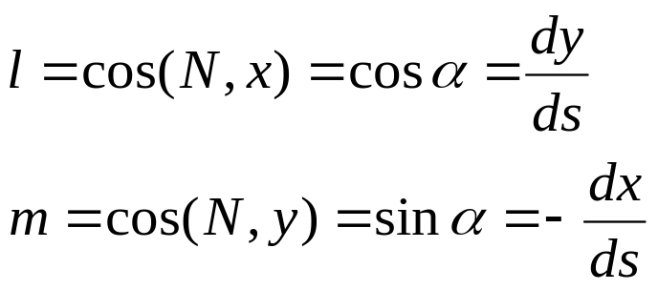
Boundary conditions expressed in terms of complex function
In plane problems, the general stress boundary condition is
B
N
We have
For an arbitrary curve AB shown in the Figure
A

Slide 5
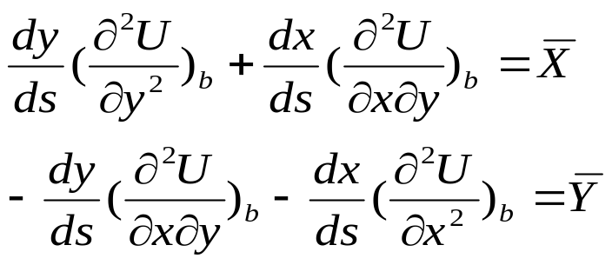
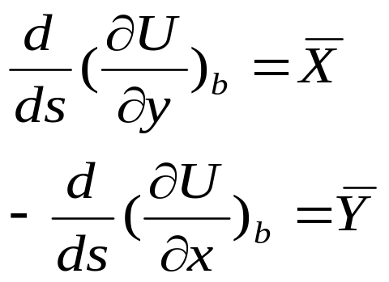
Boundary conditions expressed in terms of complex function
From
and
B
N
o
A
so

Slide 6
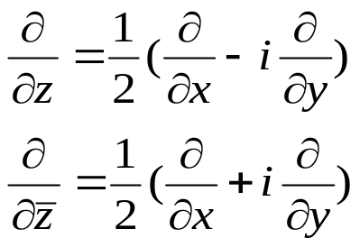
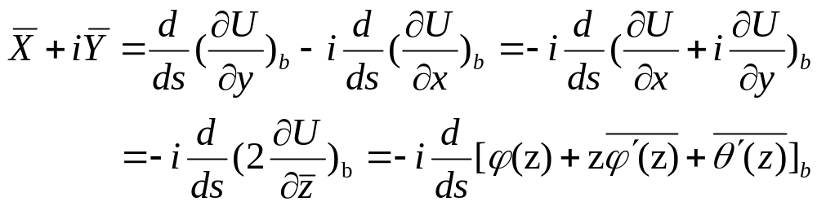
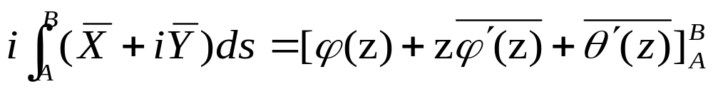
Then
N
B
Multiply ids in both sides and integrating from point A to B
o
A

Slide 7
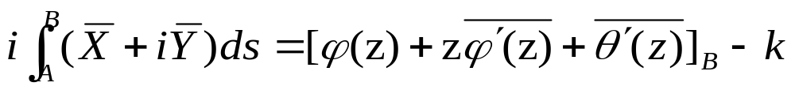
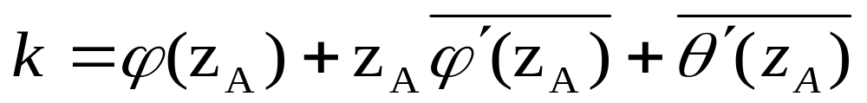
Actually, point A is a base point selected, and B is an arbitrary point in the boundary.
B
where
N
o
A

Slide 8
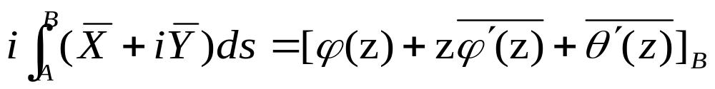

Because stresses are the derivatives of the stress functions, that means we can add any constants, the stress and displacement will not change. We can find a constant which can delete the constant k, so we have
B
N
This means the value of function
in an arbitrary point z equals the resultant from the base point to point z times i.
o
A

Slide 9
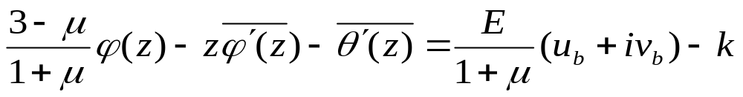
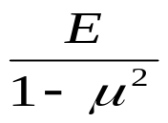
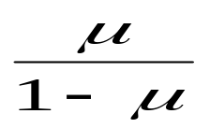

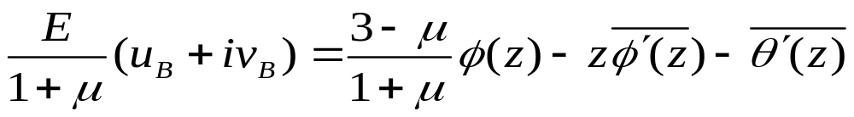
For displacement boundary, similarly, we have
For plane strain problem, we only change E to
and
to
B
N
o
A

Slide 10
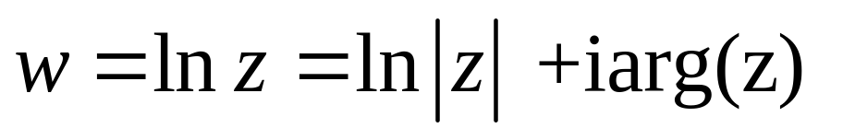

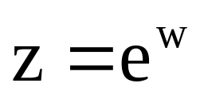
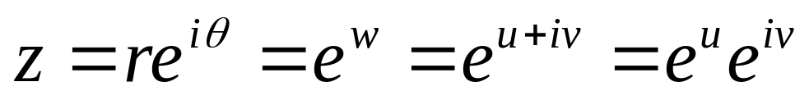

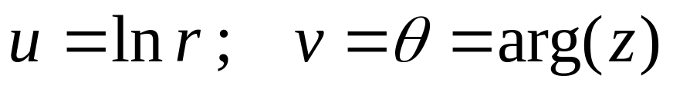

Stress single-valued conditions
at multi-connected zone
let
then
C0
C_{k}

Slide 11


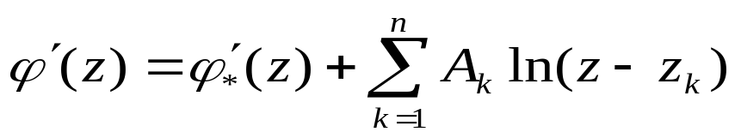
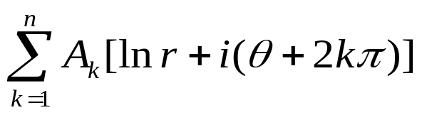

Stress single-valued conditions at multi-connected zone
Because stresses must be single-valued,
So the real part of
must be single-valued. But its imaginary may not be single-valued.
So,
C0
C_{k}
where
is a single-valued function

Slide 12
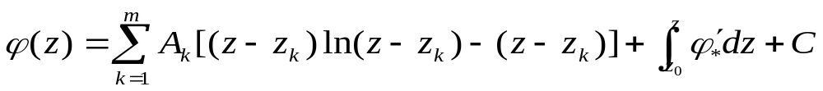
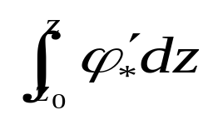

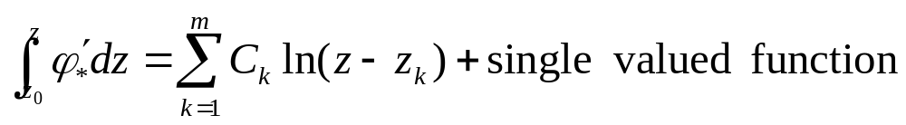
Stress single-valued conditions at multi-connected zone
Integrating the above equation
where
is a single-valued function, but
may also increase by
C0
C_{k}

Slide 13
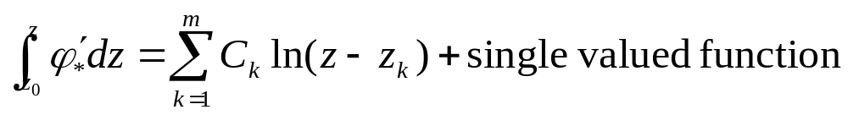
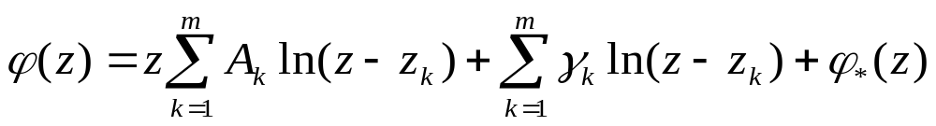

Stress single-valued conditions at multi-connected zone
Let
so
C0
C_{k}
where
Is a single-valued analytical function

Slide 14

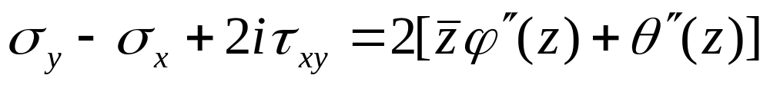


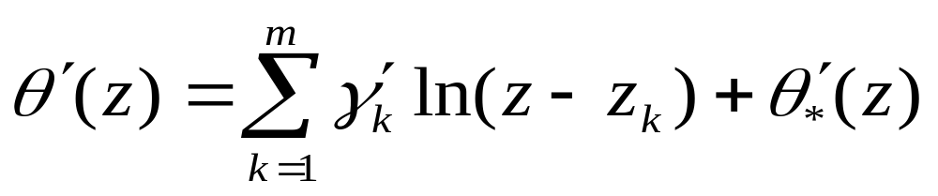

Stress single-valued conditions at multi-connected zone
Now Consider this equation
It can be seen
is single-valued and analytic. and
must be
single-valued and similarly we have
C0
C_{k}
where
is single-valued and analytic

Slide 15
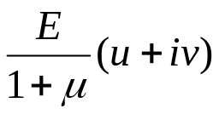
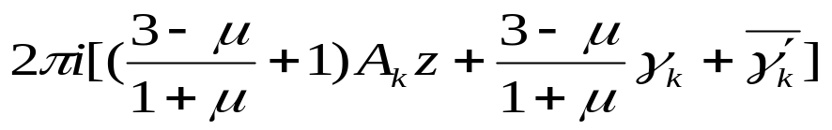
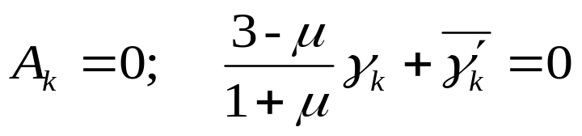
Substituting them into the equation
go along C_{k}, the increment of
is
C0
C_{k}
So the displacement single-valued condition is

Slide 16
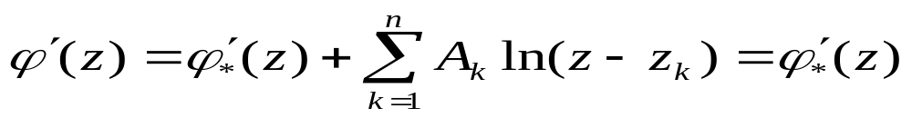

So the displacement single-valued condition is
C0
C_{k}
Now using interior boundary conditions to determine the unknown parameters

Slide 17
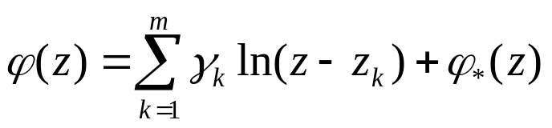

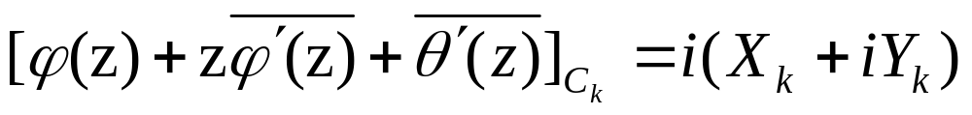
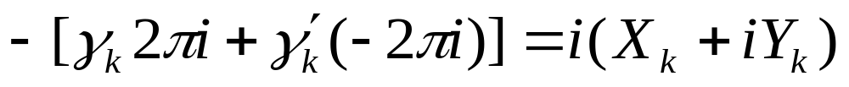
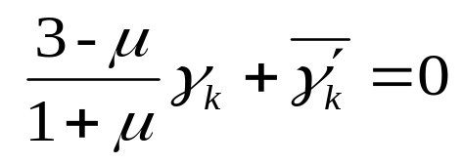
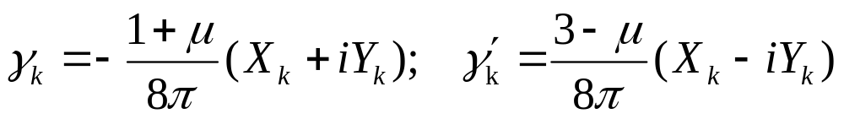
Now using interior boundary conditions
to determine the unknown parameters; integrating along C_{k ,}so we have
We have
C0
C_{k}
A B
Combining
One can obtain

Slide 18
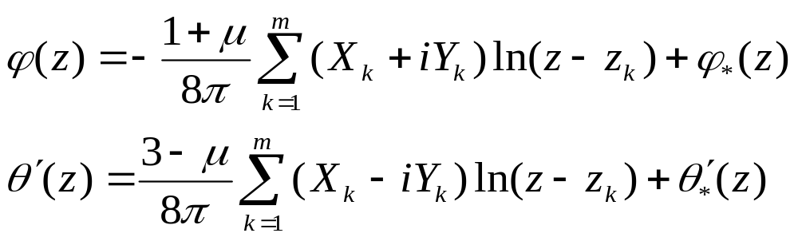
Finally, one can obtain the complex stress functions
C0
C_{k}
Therefore, in order to satisfy the single-valued conditions, the complex stress function must be as shown as the above.

Slide 19
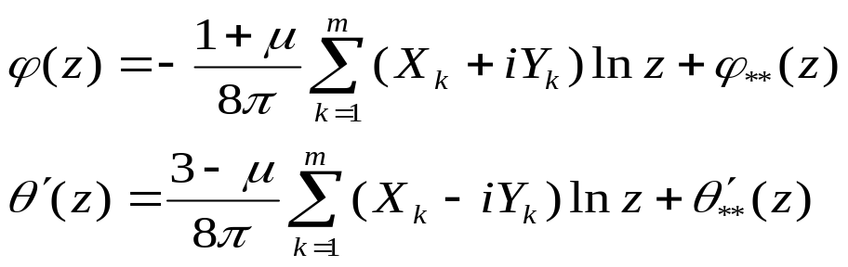


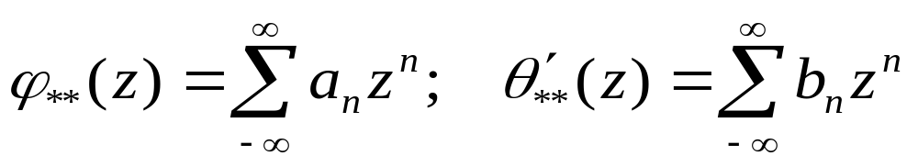
For Infinitely large multi-connected elastic body
Make a circle with a such large radius that all the interior boundaries are inside this circle. If z is located outside this circle, we have
Therefore,
Where,
are analytic in the zone
C0
Ck
R
So, substitute them into the above equation, we have

Slide 20
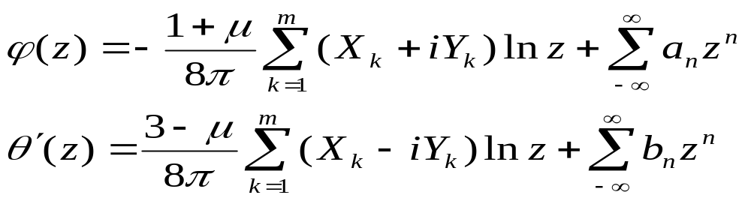

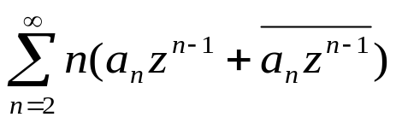

For Infinitely large multi-connected elastic body
We have
Substituting them into the equation
we have
It can be seen that when z→∞, the first two terms tends towards zero, and the term
tends towards infinity, so in order to limit the stresses

Slide 21





Similarly, from this equation we have
Therefore, in order to limit the stresses
Where B, C, B’, C’ are real constants, and
Let
will not change stresses
so

Slide 22

For Infinitely large multi-connected elastic body
One can find when z→∞
So in the infinite place, we have

Slide 23



For Infinitely large multi-connected elastic body
Suppose
are the principal stresses in the infinite place and α
Is the angle between x-axis and
and we have

Slide 24



For Infinitely large multi-connected elastic body
So, we have
Thus
Usually, the principal stresses are known, so the constants B, B’, C’ can be obtained

Slide 25
Where X_{k}, Y_{k} are the resultant of internal boundaries;
and
C0
C_{k}

